Slide 1


Career Paths in Cybersecurity
Notes:
Begin by potentially instilling additional motivation in students. I would discuss certifications, courses, competitions and potential jobs and salaries. This should be in the first lecture (immediately following my introduction to students).
Don’t worry if you don’t understand everything
If you have questions, put your hand up to ask anytime

Slide 2
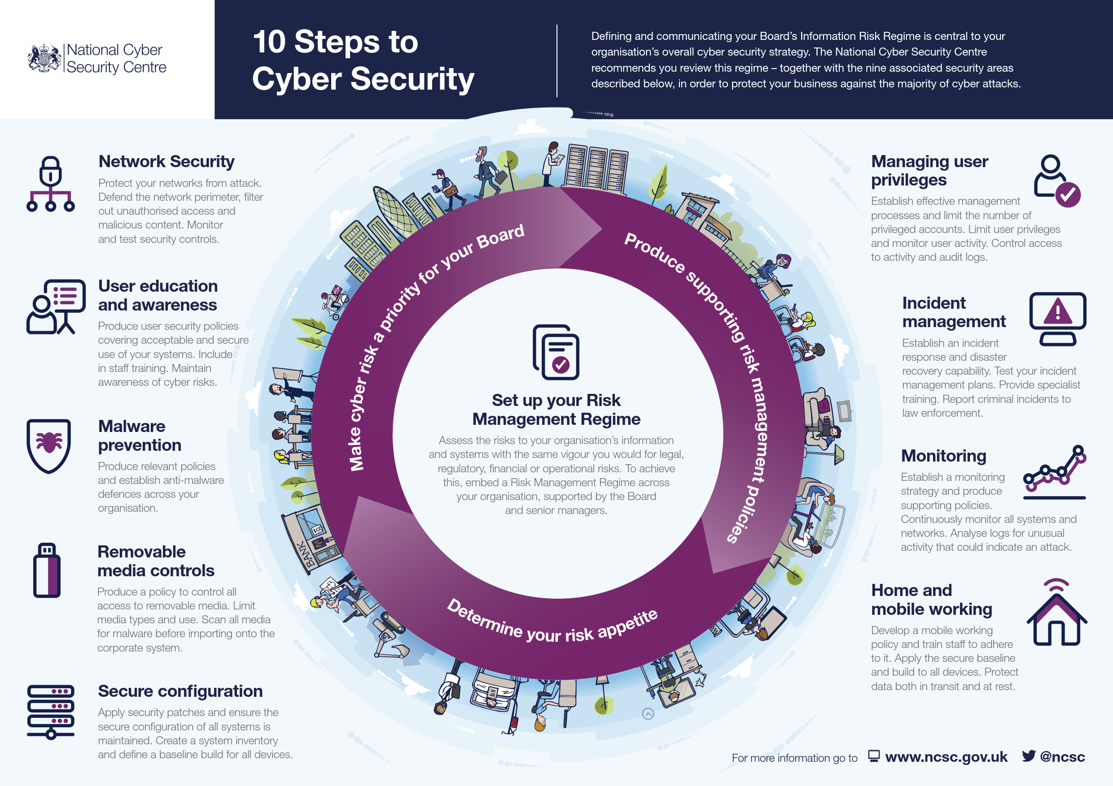

https://www.ncsc.gov.uk/files/NCSC%2010%20Steps%20To%20Cyber%20Security%20NCSC.pdf

Slide 3

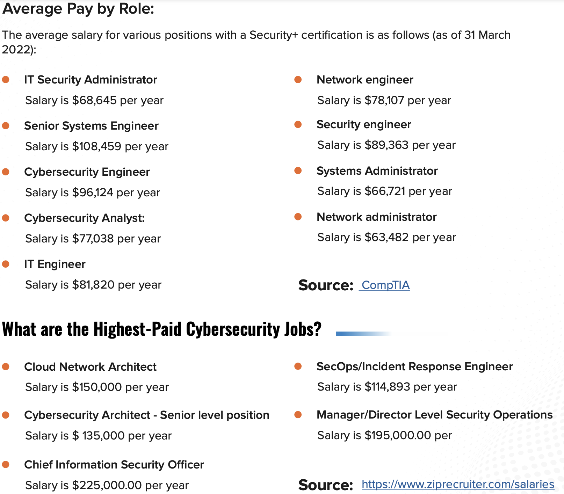
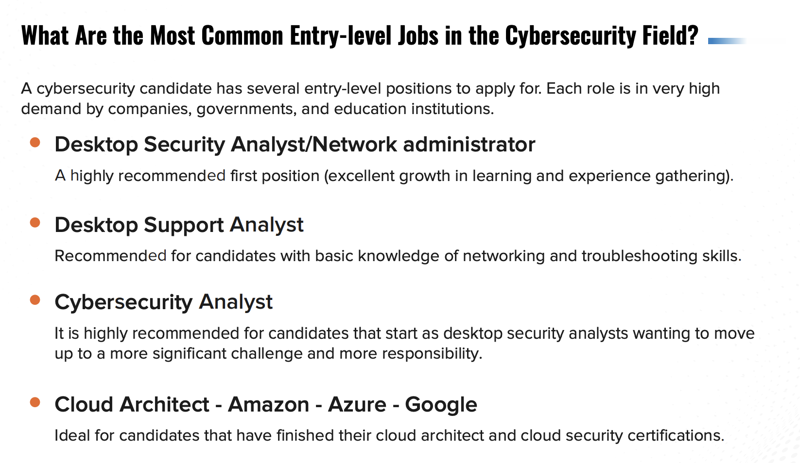
https://www.ciat.edu/pdf/assets/roadmap-for-success-cybersecurity-ebook.pdf
Check Google Doc
Jobs & Salaries

Slide 4
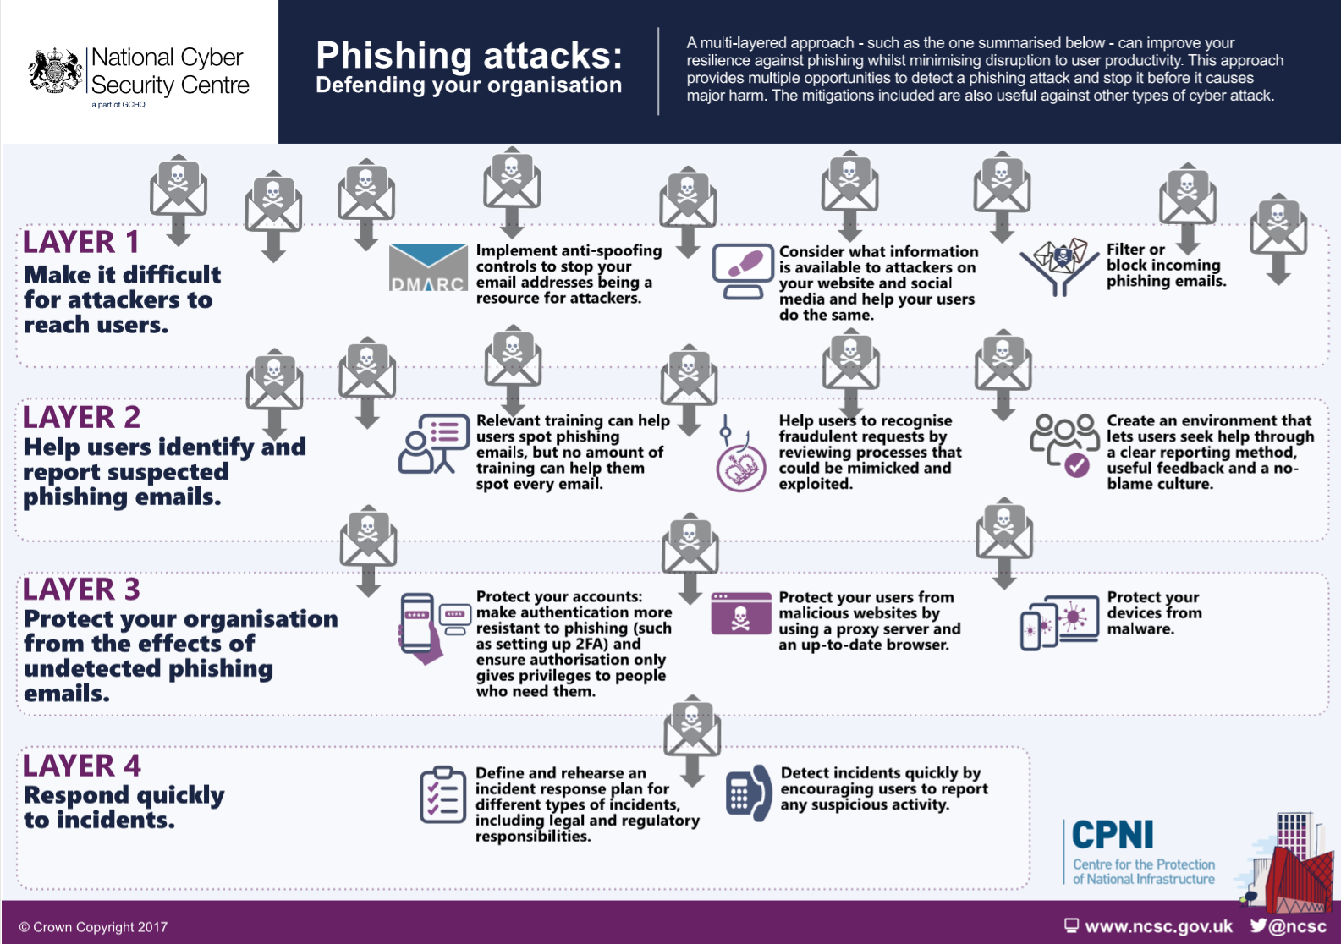
https://www.ayrmer.co.uk/blog-articles/Cyber+security+advice/

Slide 5
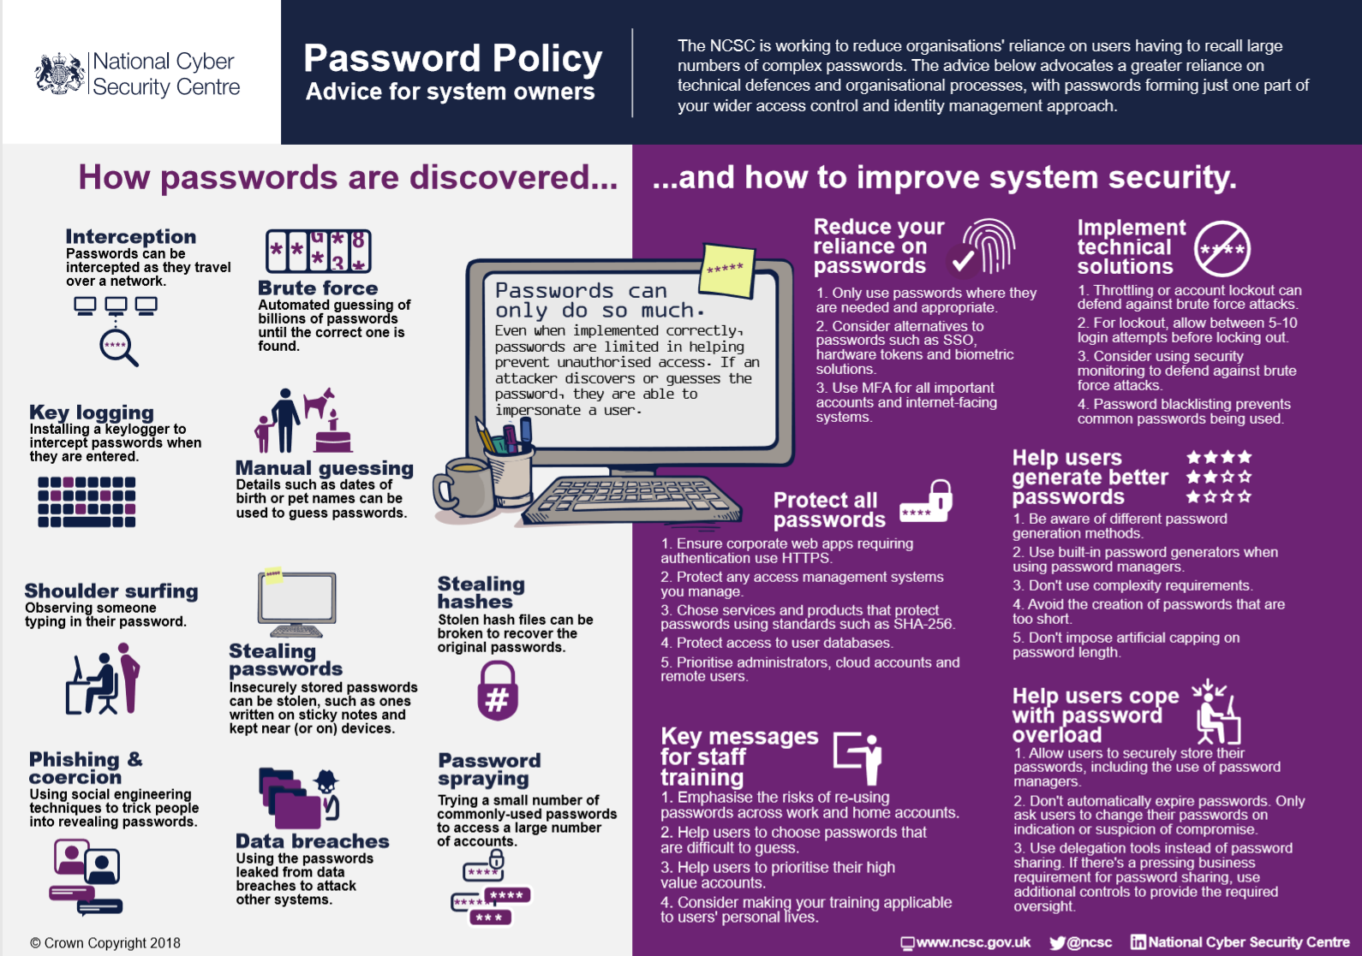
https://www.ayrmer.co.uk/blog-articles/Cyber+security+advice/

Slide 6
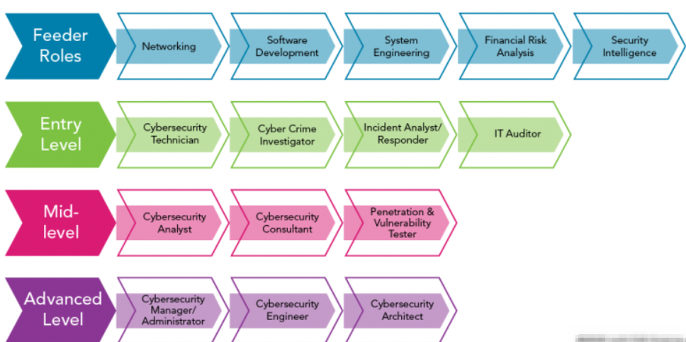
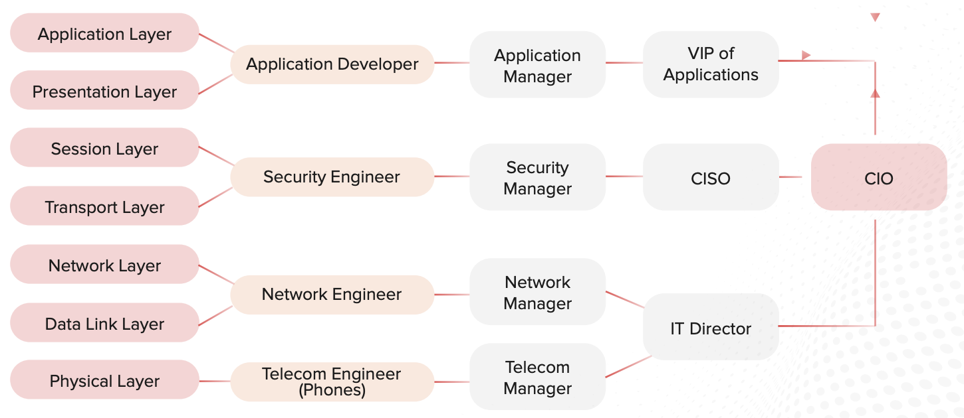
https://www.google.com/url?sa=i&url=https%3A%2F%2Fmedium.com%2F%40kumarishefu.4507%2Ftry-hack-me-careers-in-cyber-269de78589be&psig=AOvVaw0AhaS0sSxU9ah9dy6jLpnH&ust=1717800838275000&source=images&cd=vfe&opi=89978449&ved=0CBQQjhxqFwoTCOiPi-CJyIYDFQAAAAAdAAAAABAh
Cybersecurity Career Paths

Slide 7
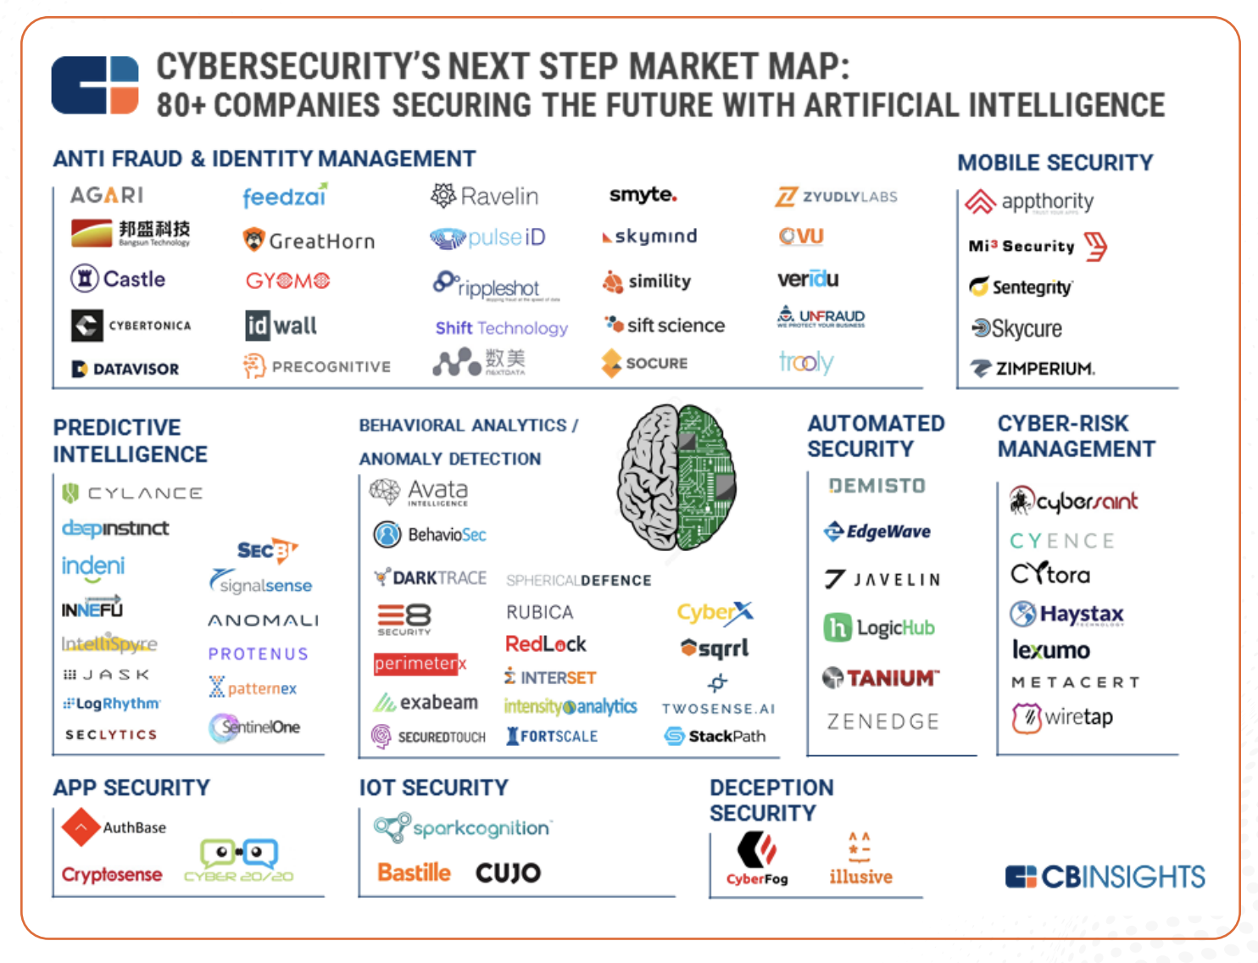

Slide 8
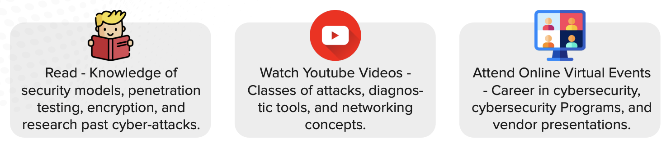
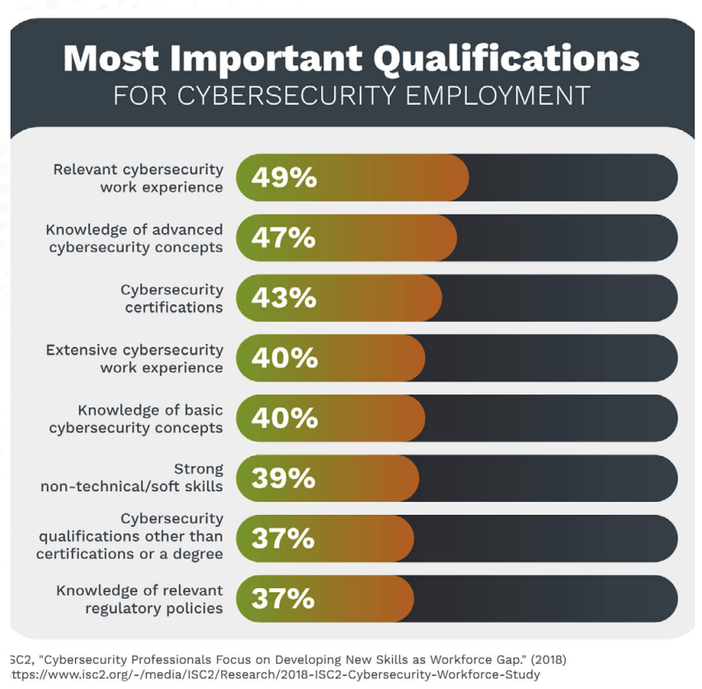
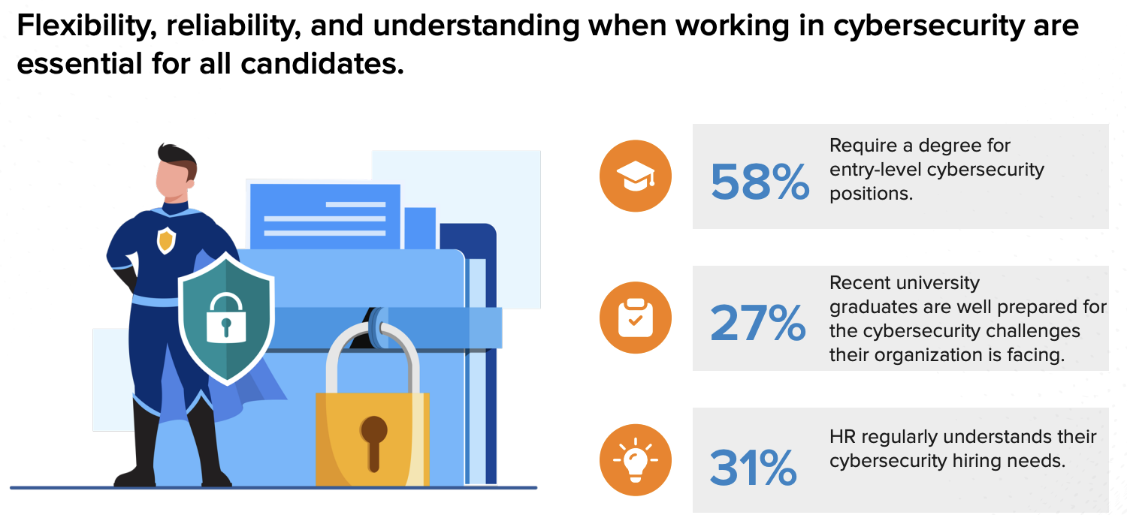
Roadmap for Success

Slide 9
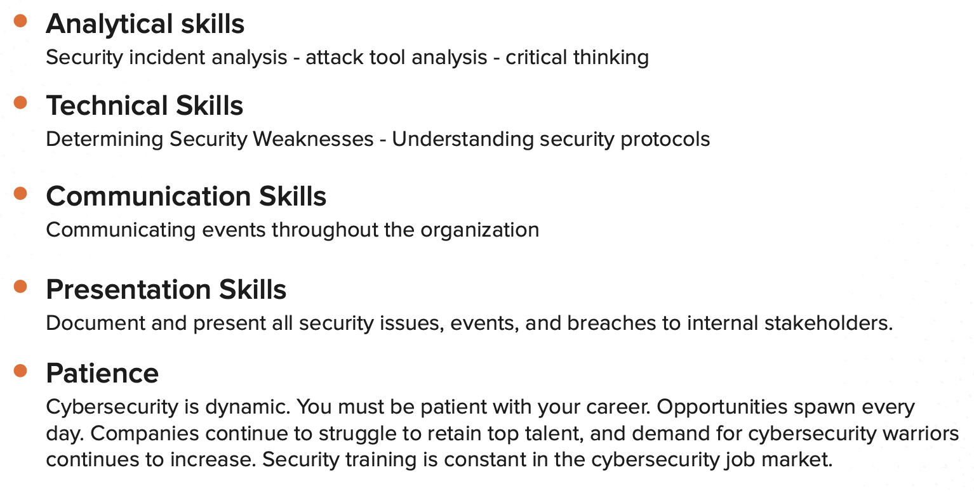
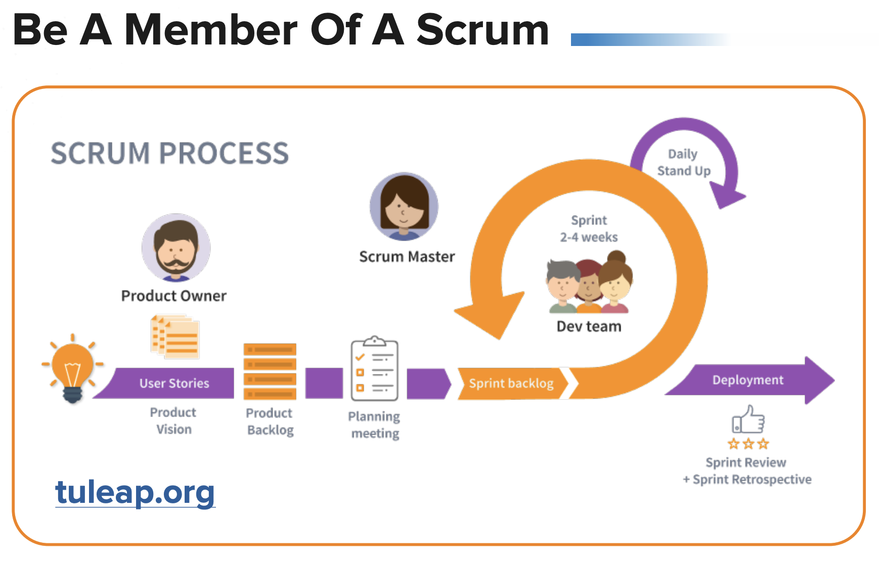

Slide 10
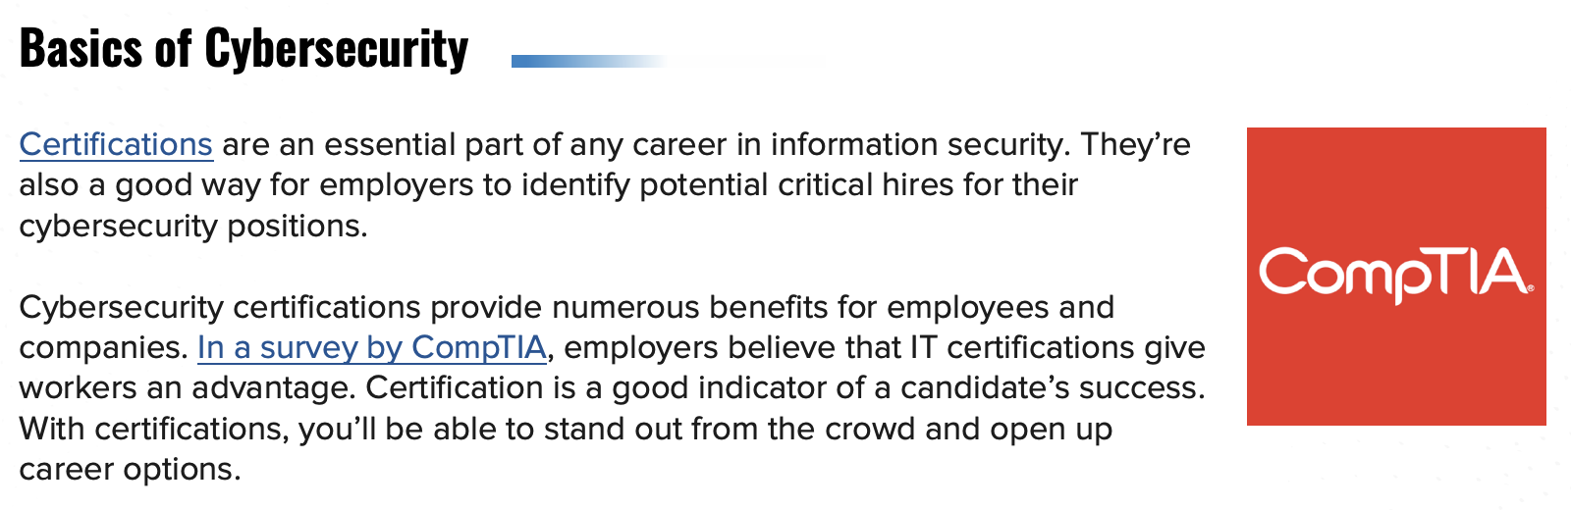
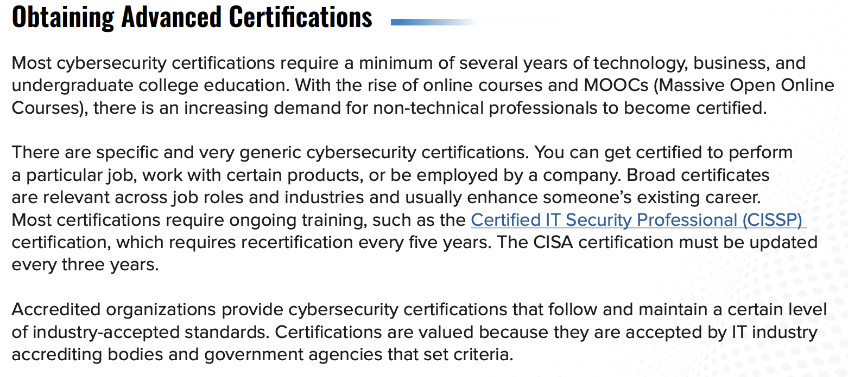
Certifications

Slide 11
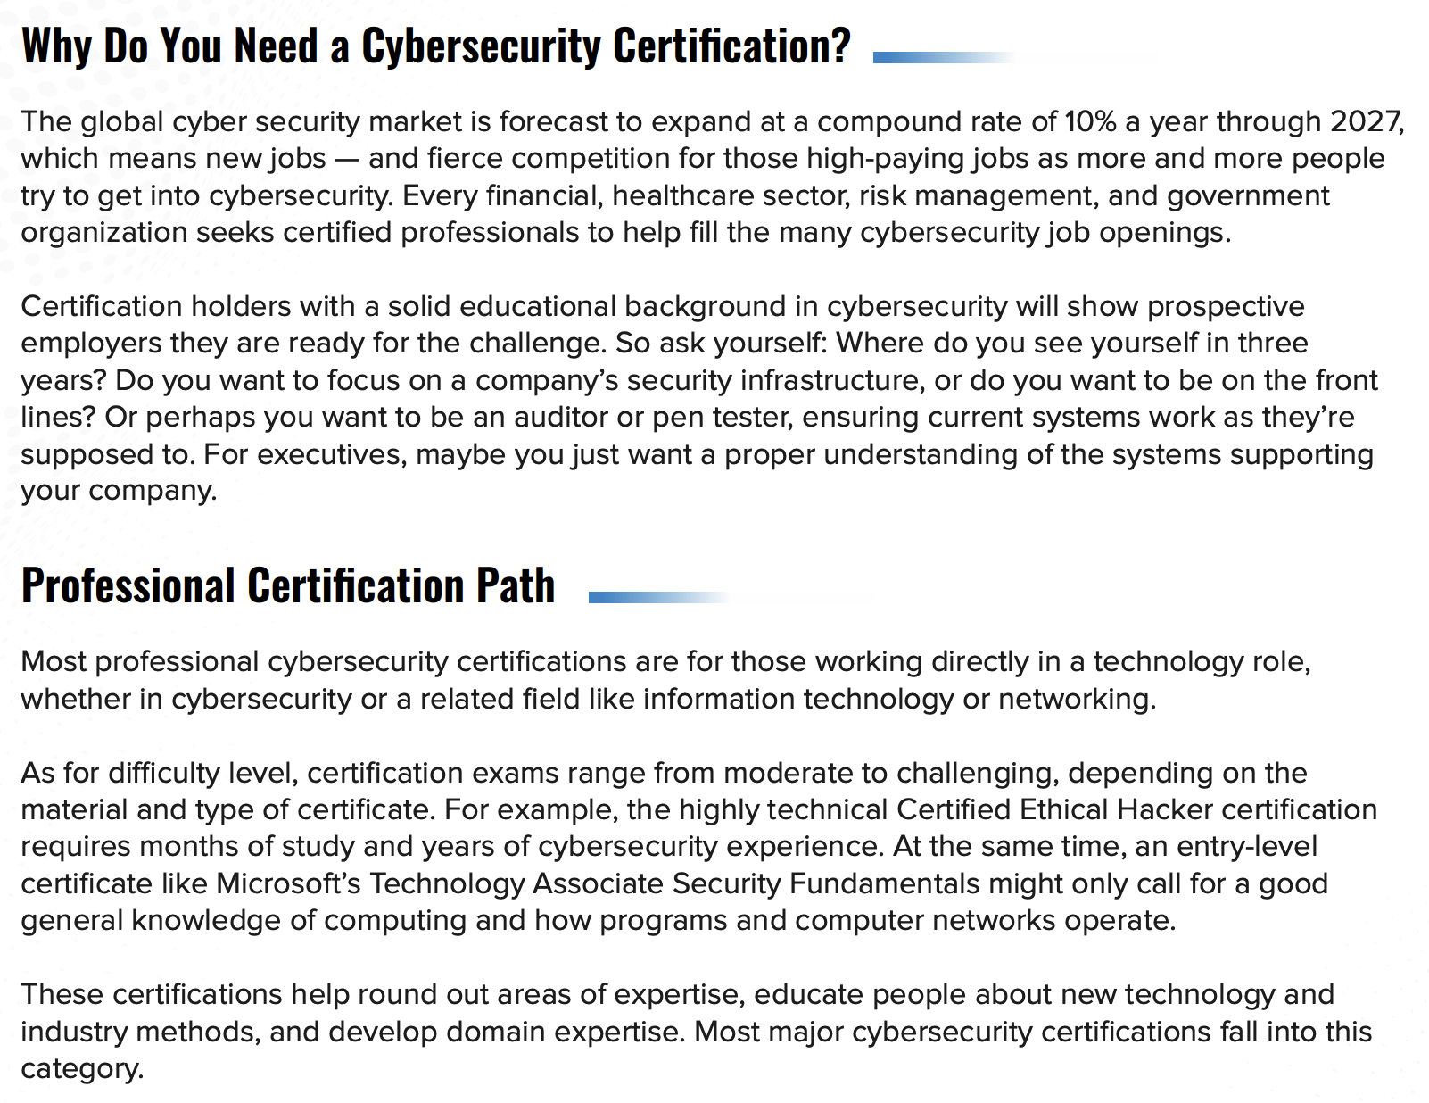

Slide 12

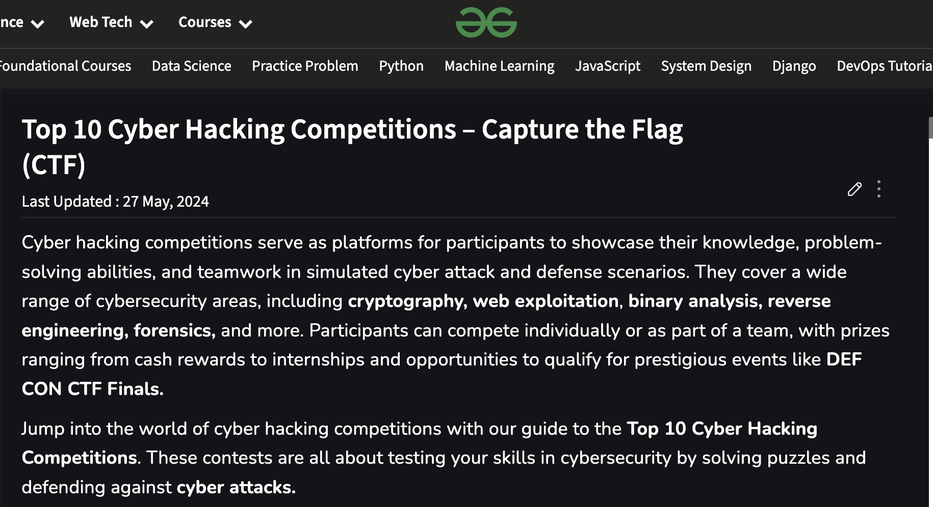

Competitions
Notes:
Whole world of competition

Slide 13



Newsletters
Notes:
Whole world of competition

